Slide 1


Siapiau 2D

Slide 2
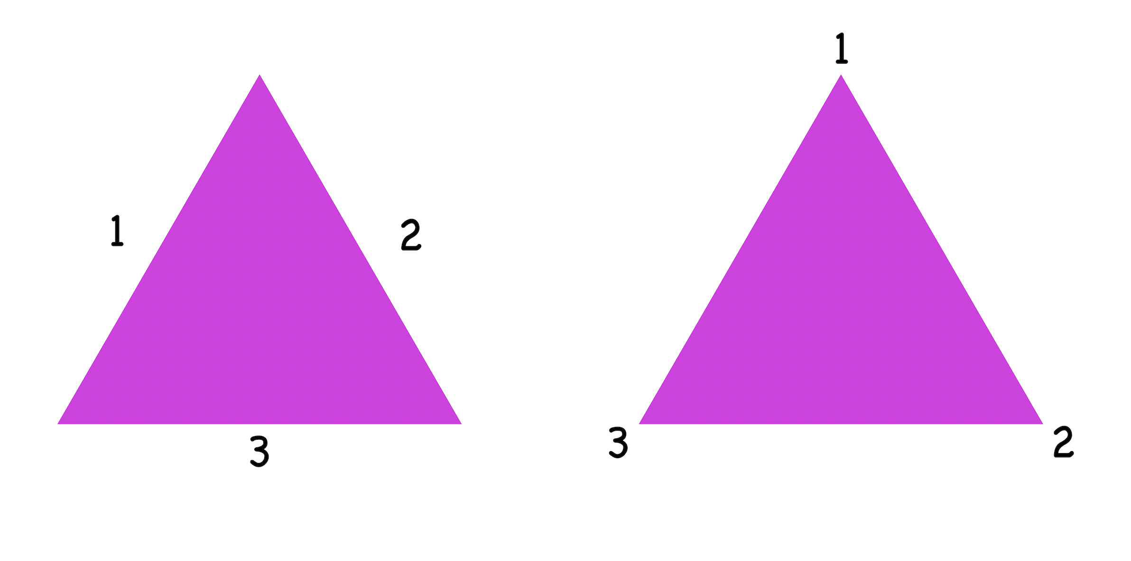
Triongl

Slide 3
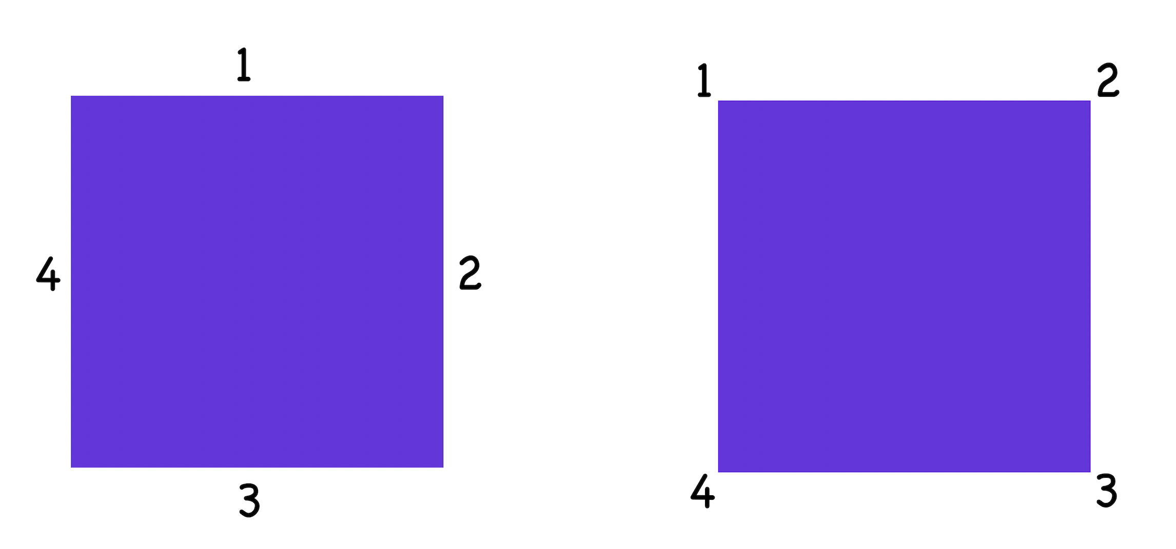
Sgwâr

Slide 4
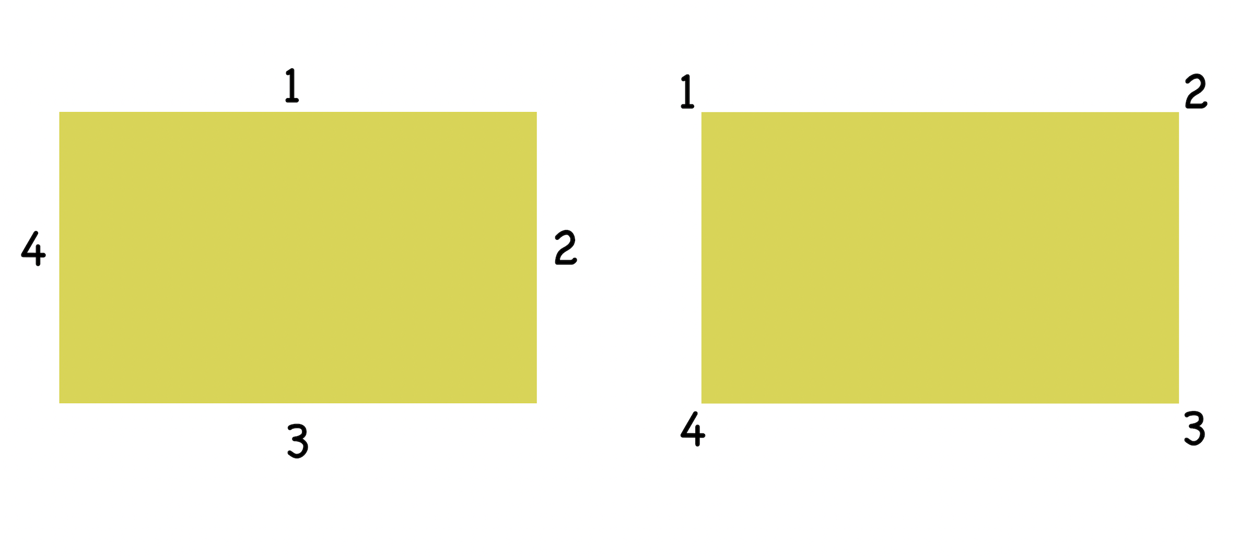
Petryal

Slide 5
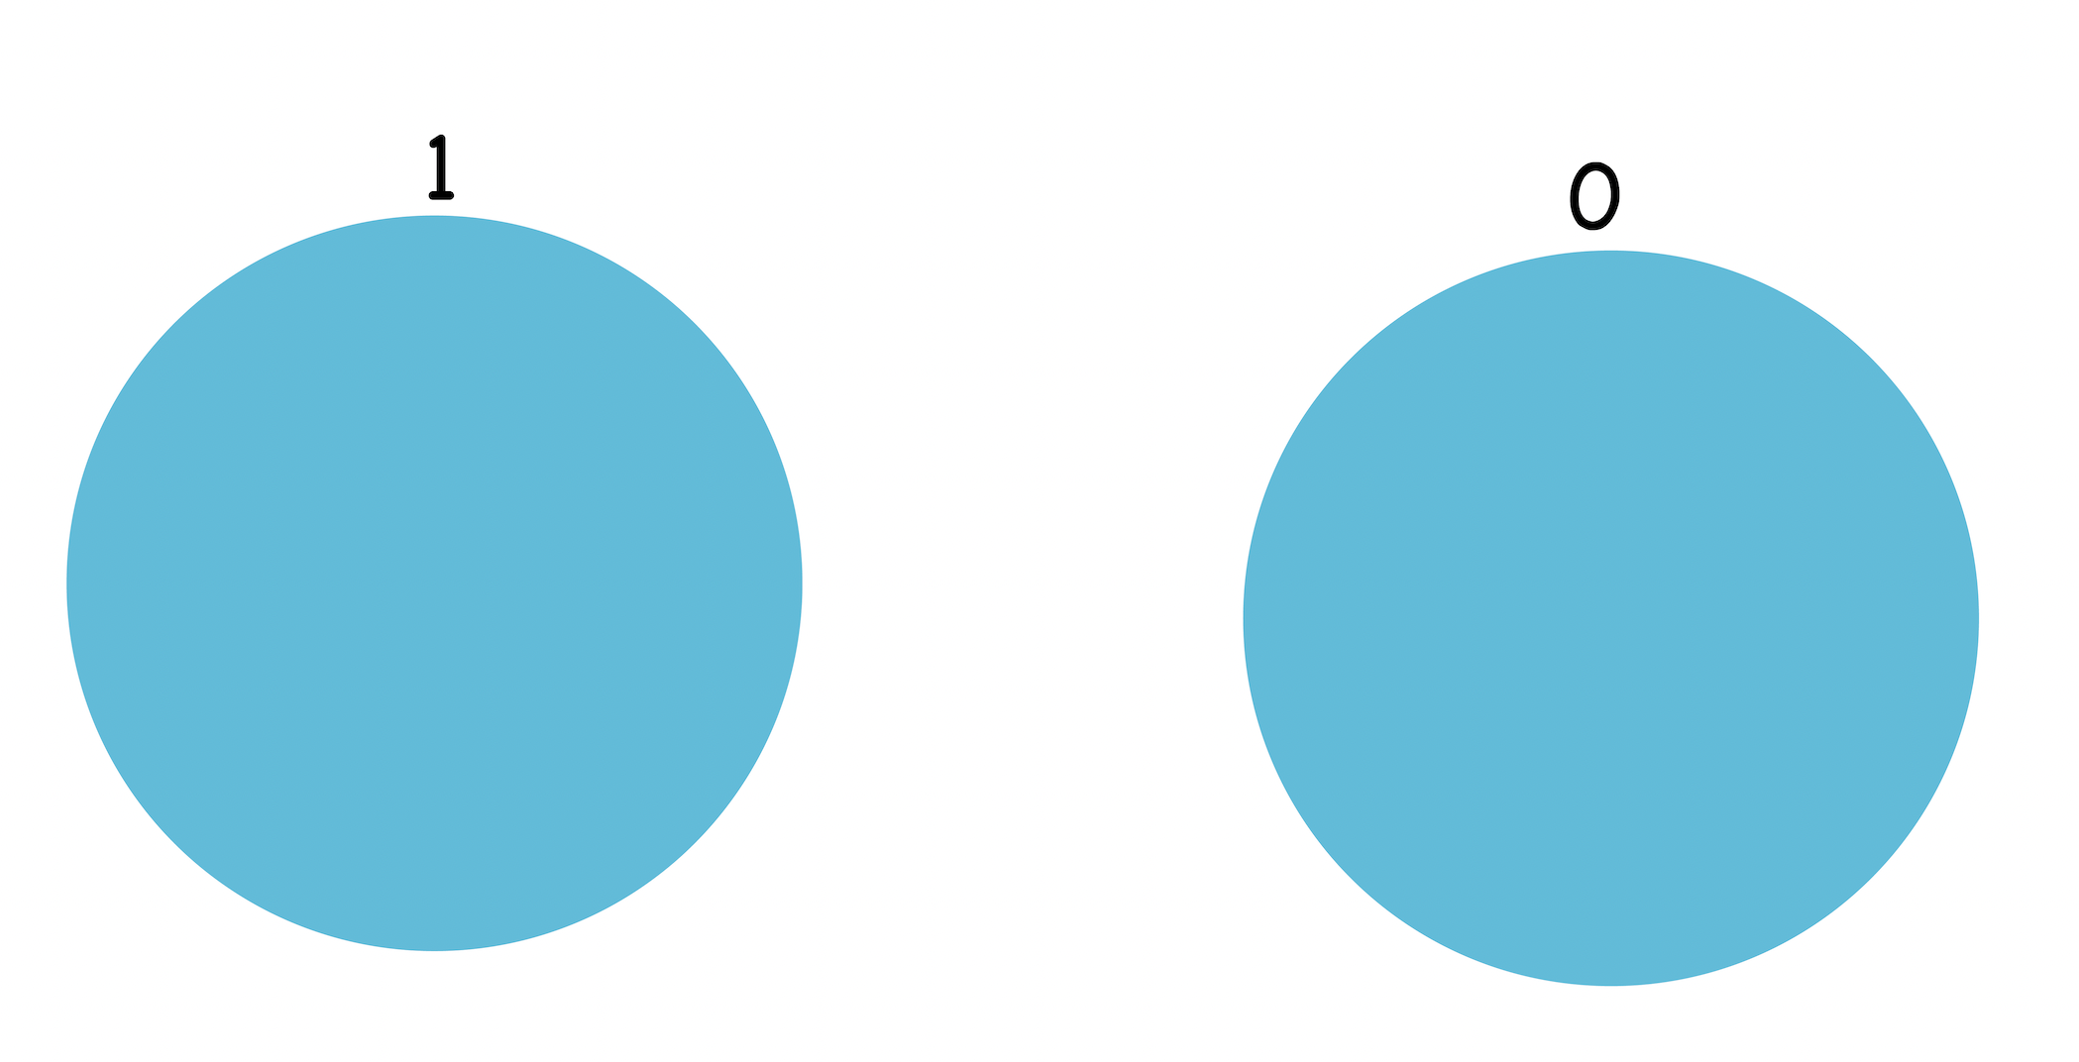
Cylch

Slide 6
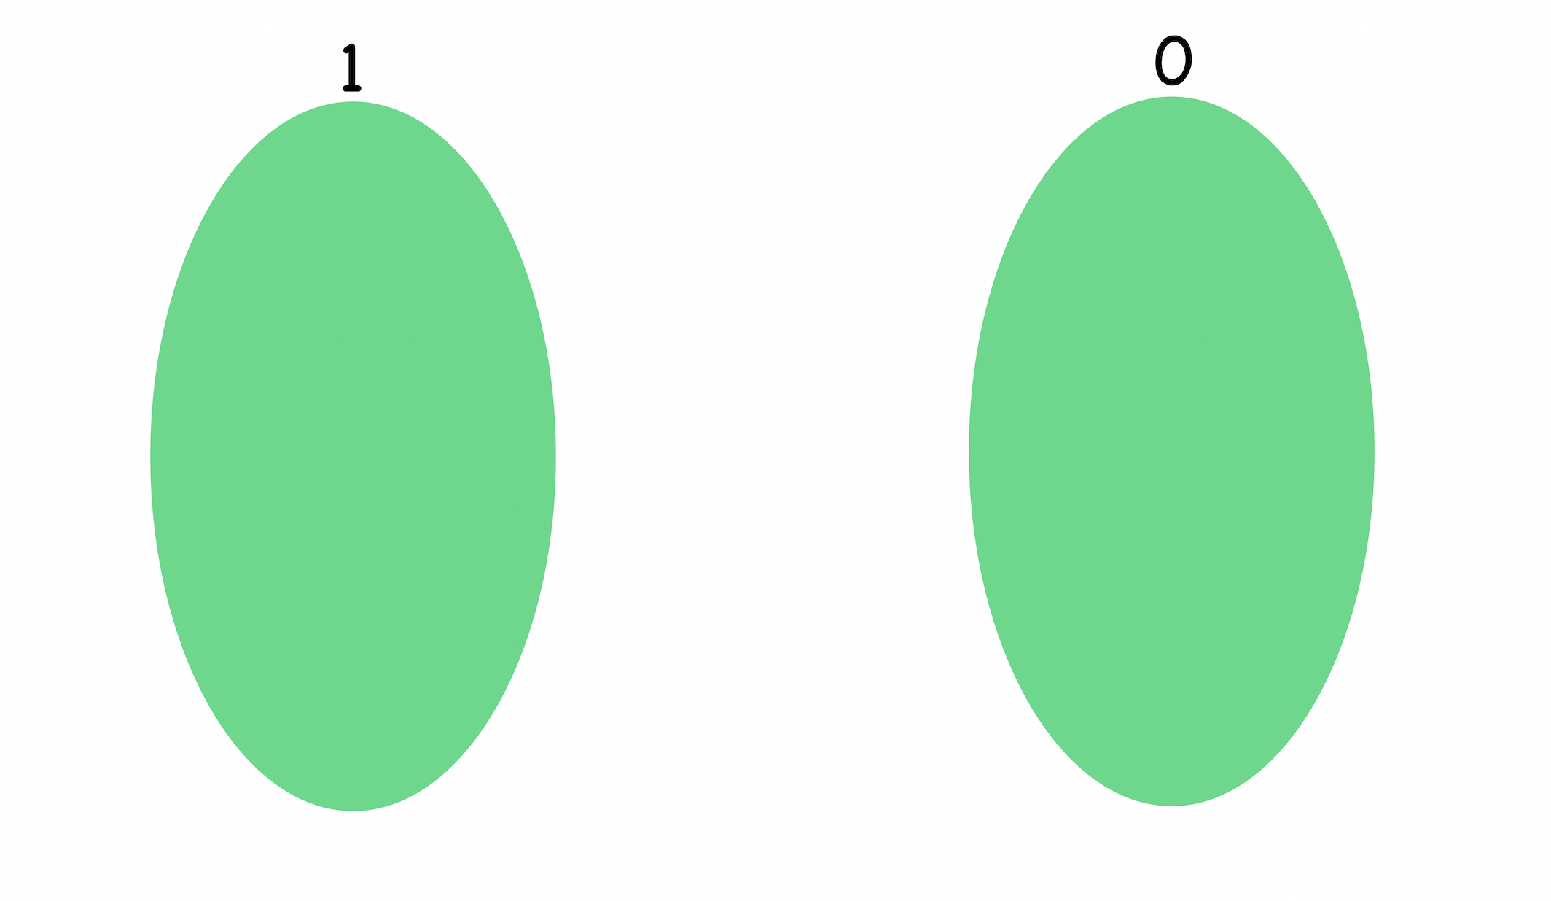
Hirgrwn

Slide 7
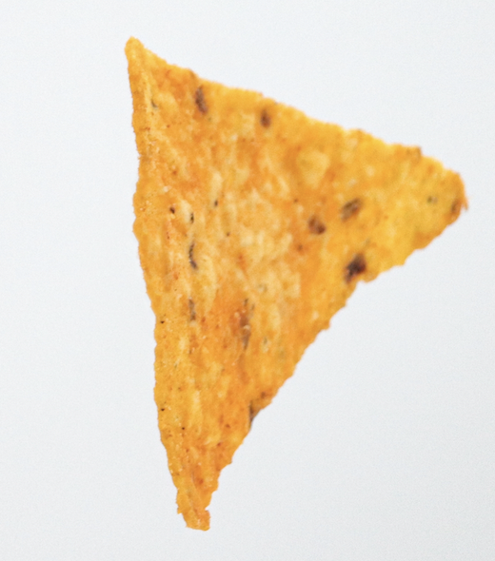
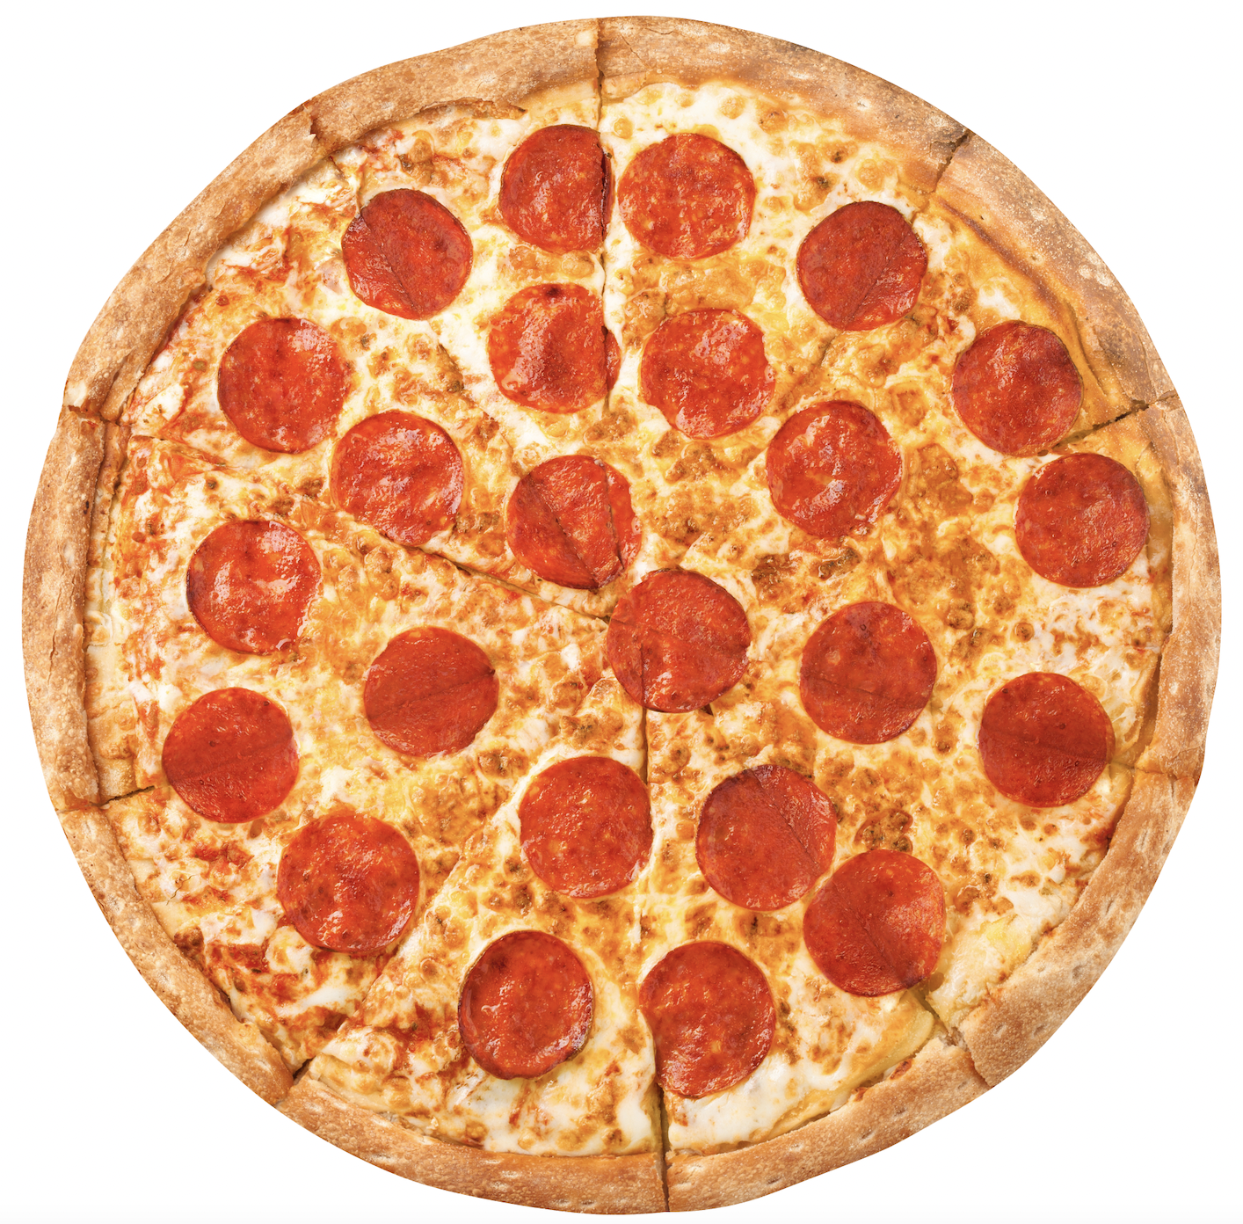
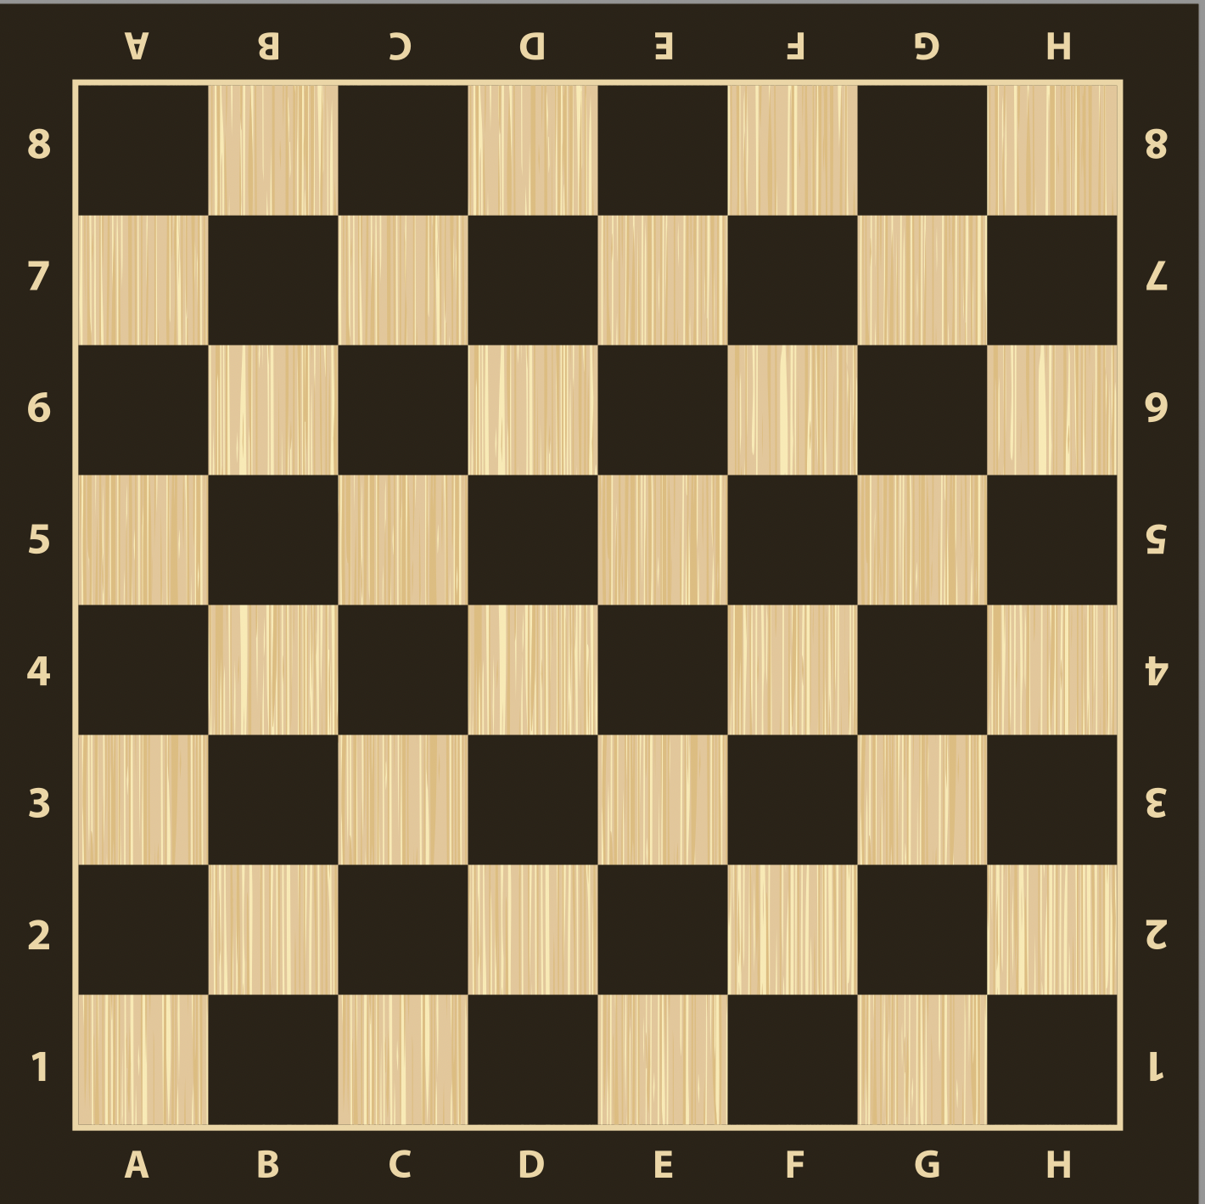
Pa siâp?
Pa siâp?

Slide 8
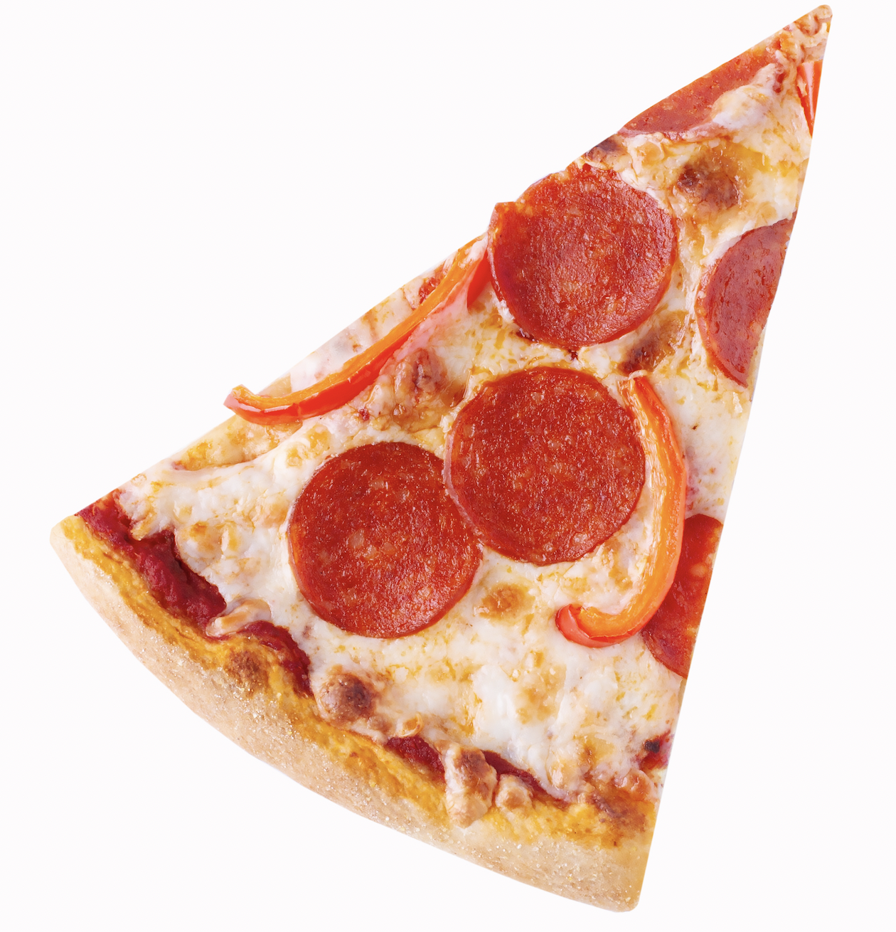

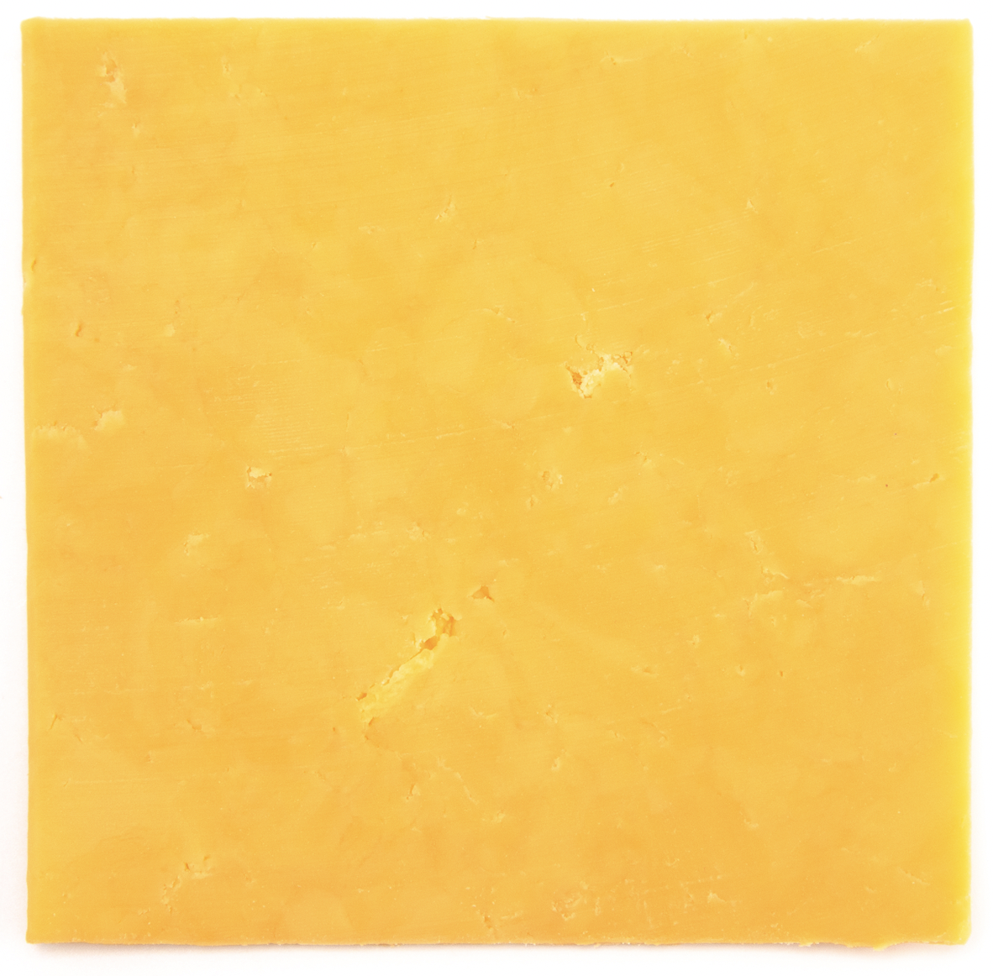
Pa siâp 1?
Pa siâp?

Slide 9


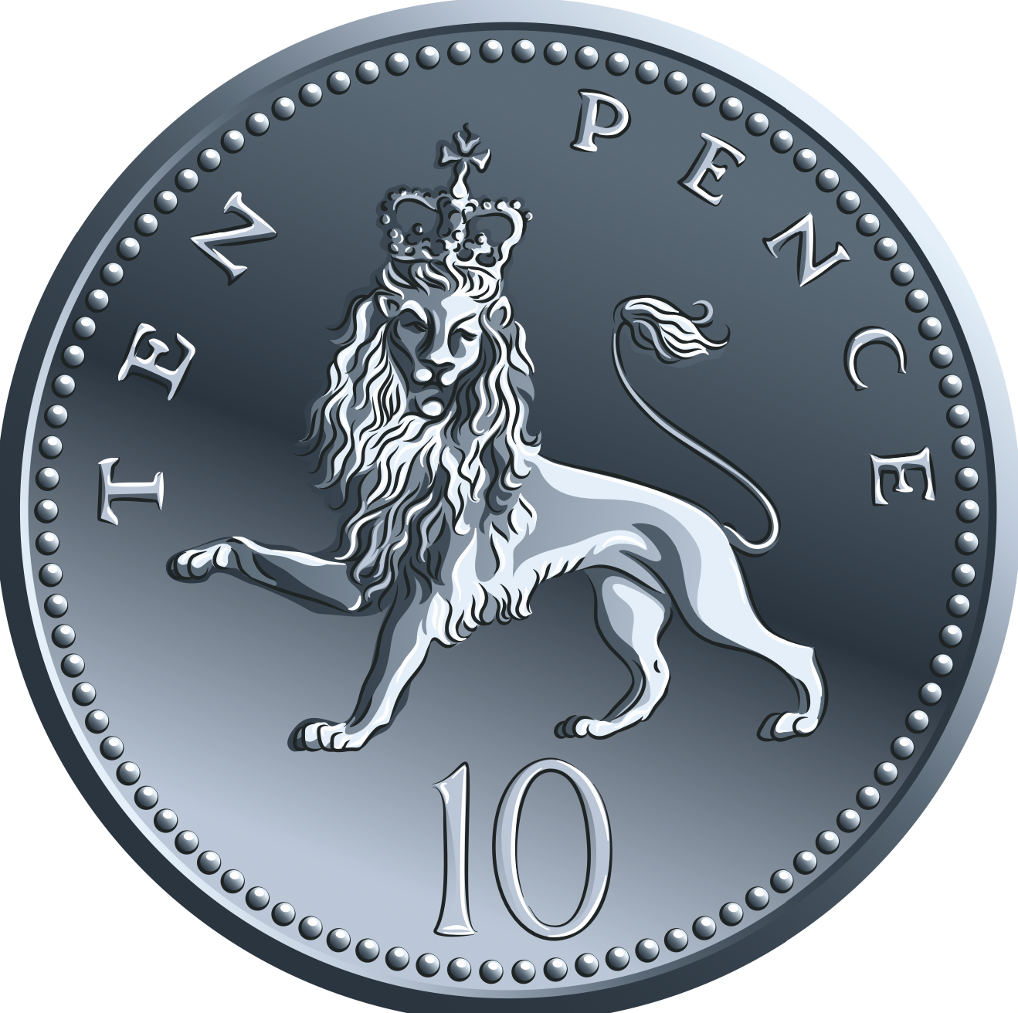
Pa siâp 2?
Pa siâp?

Slide 10
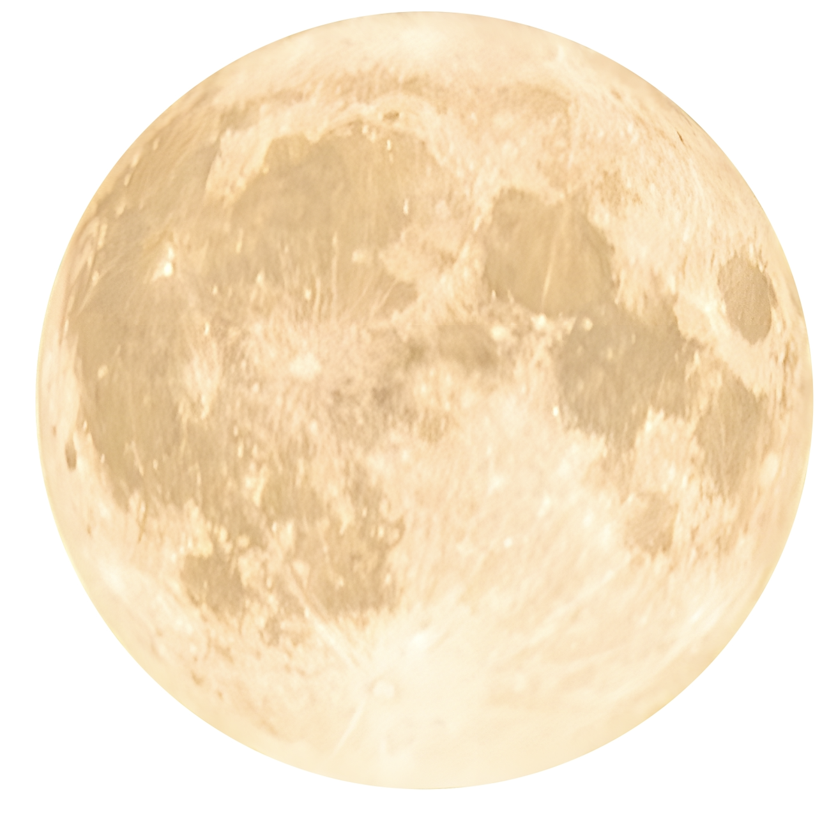

Pa siâp 3?
Pa siâp?

Slide 11

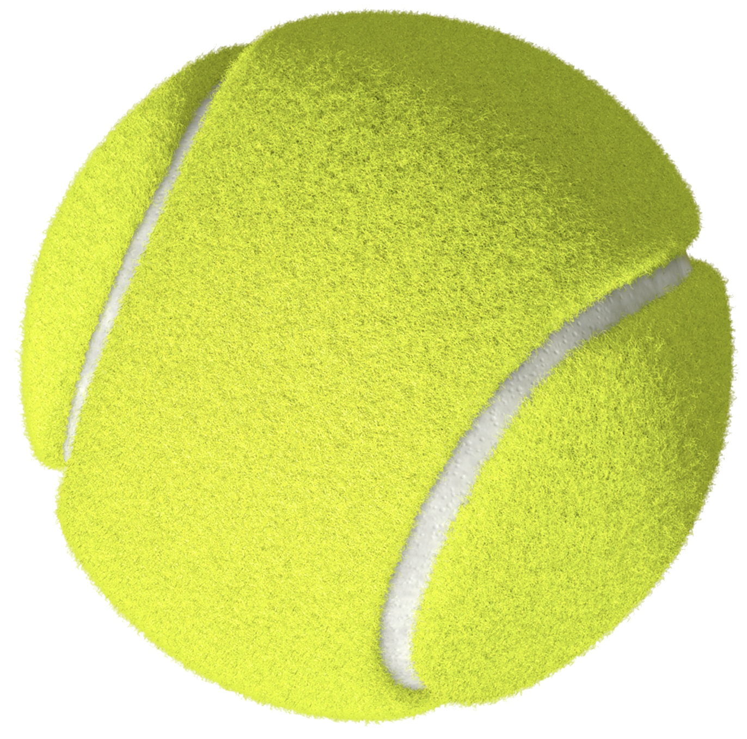
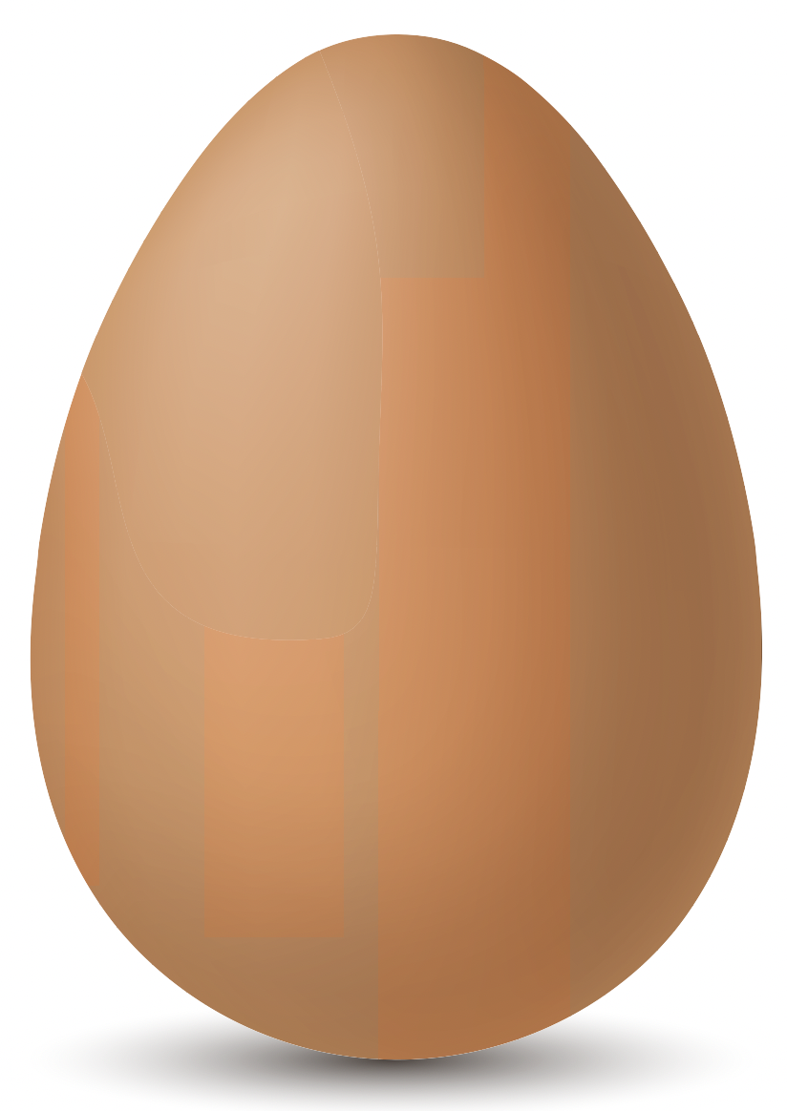
Pa siâp 4?
Pa siâp?

Slide 12


Pa siâp 5?
Pa siâp?

Slide 13


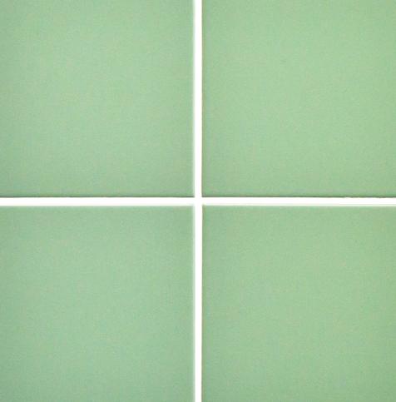
Pa siâp 6?
Pa siâp?

Slide 14
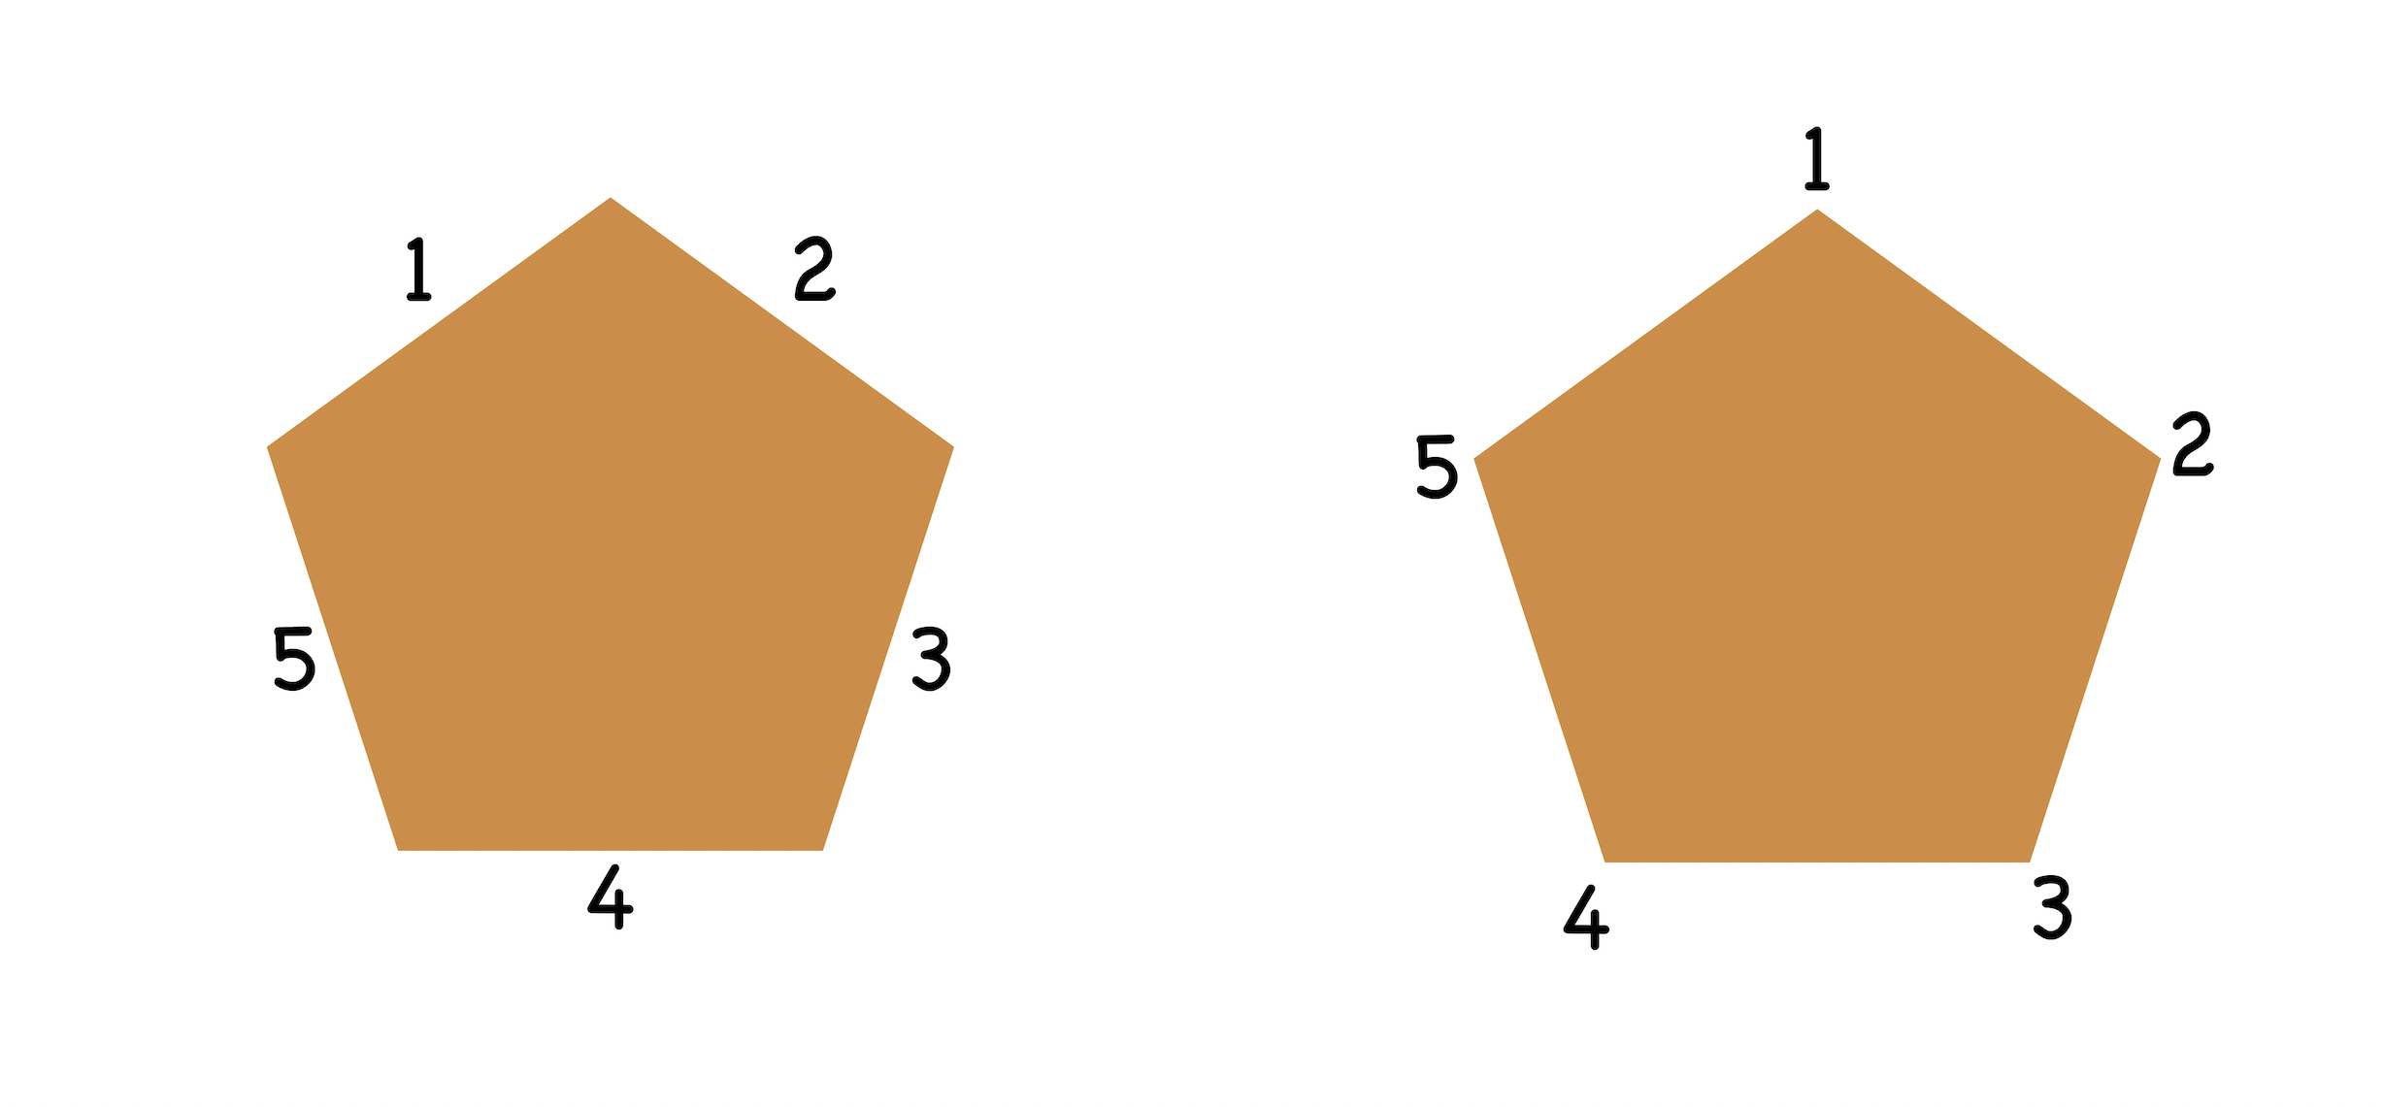
Pentagon

Slide 15
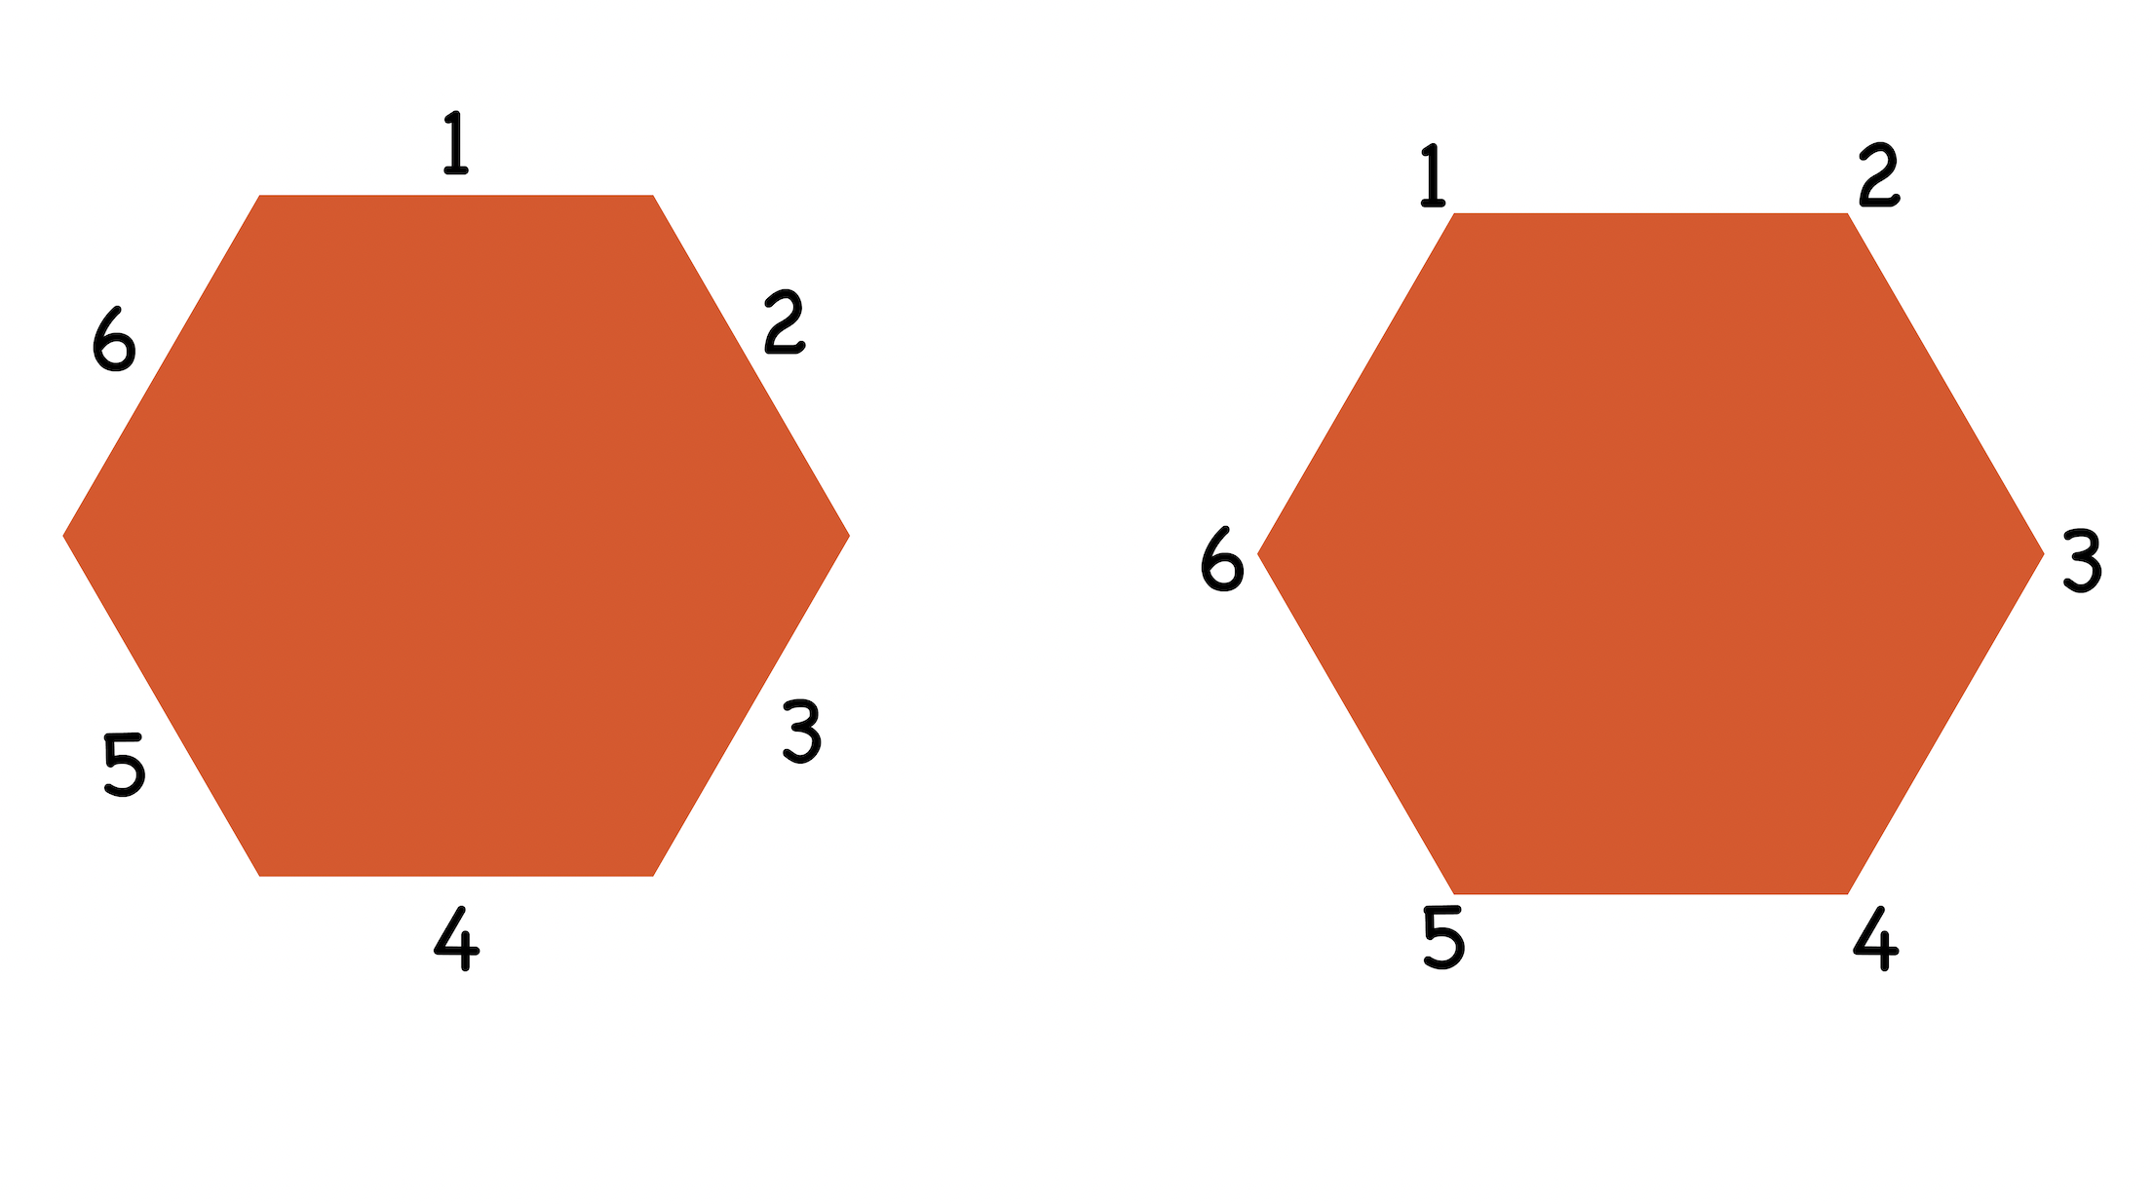
Hecsagon

Slide 16
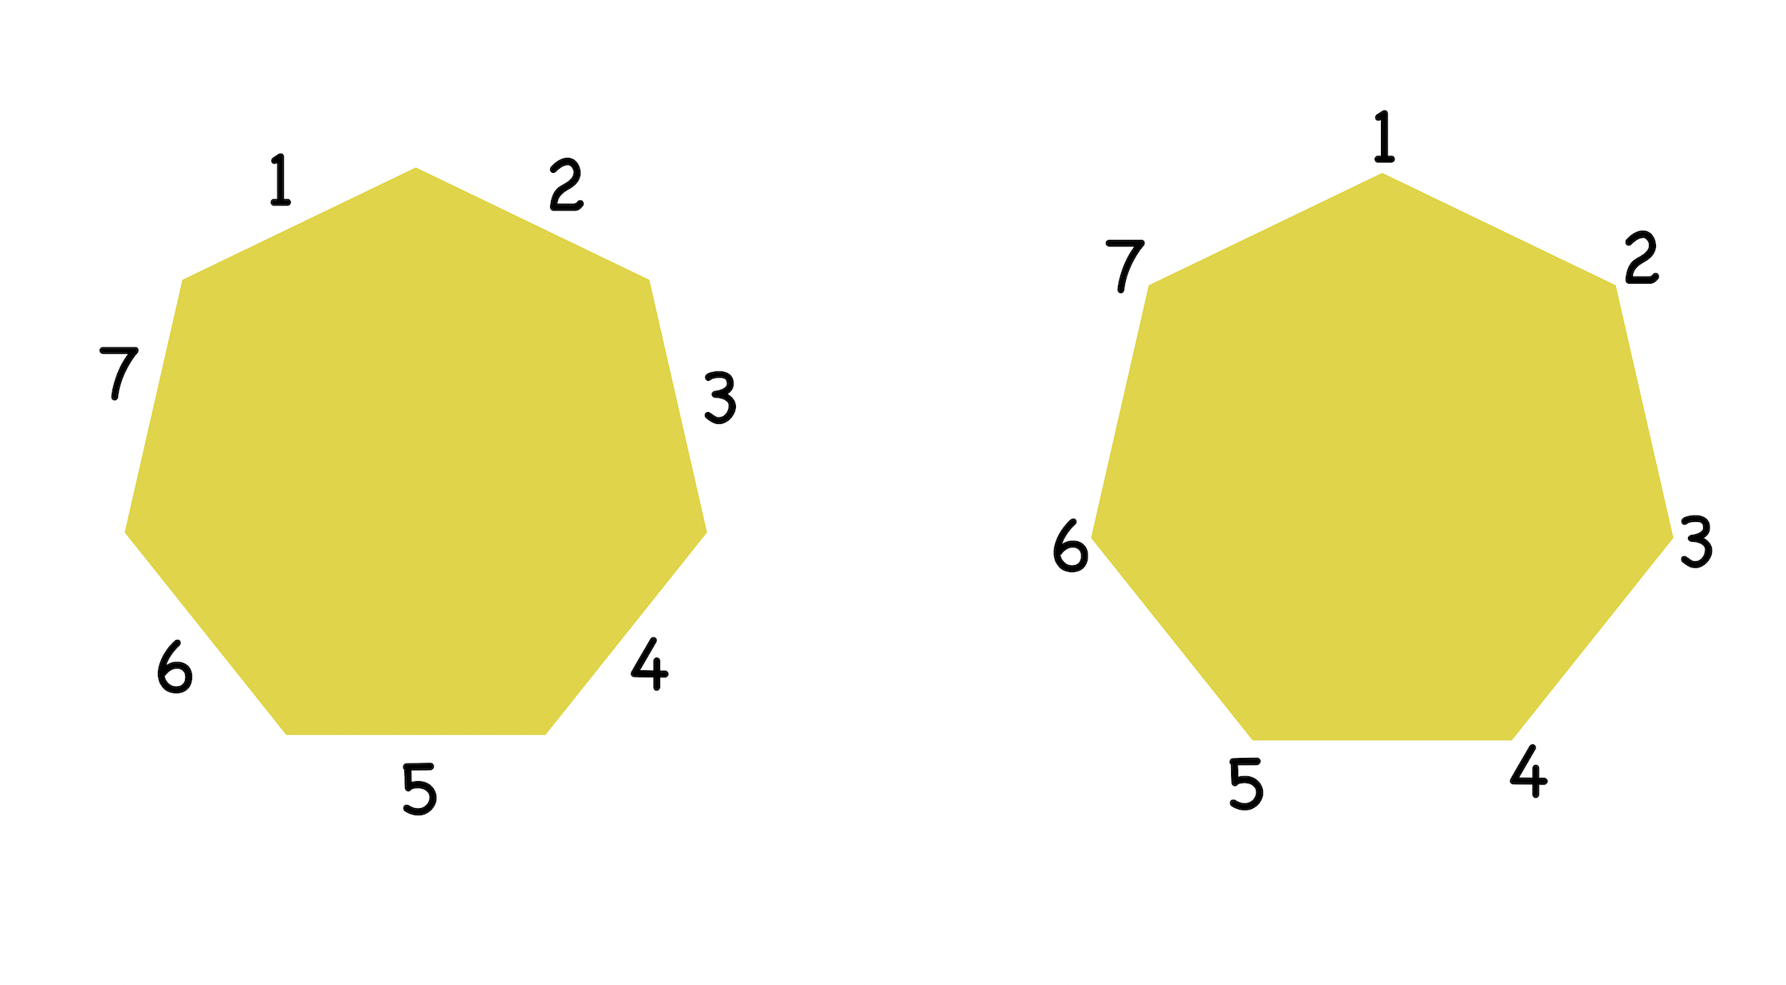
Heptagon

Slide 17
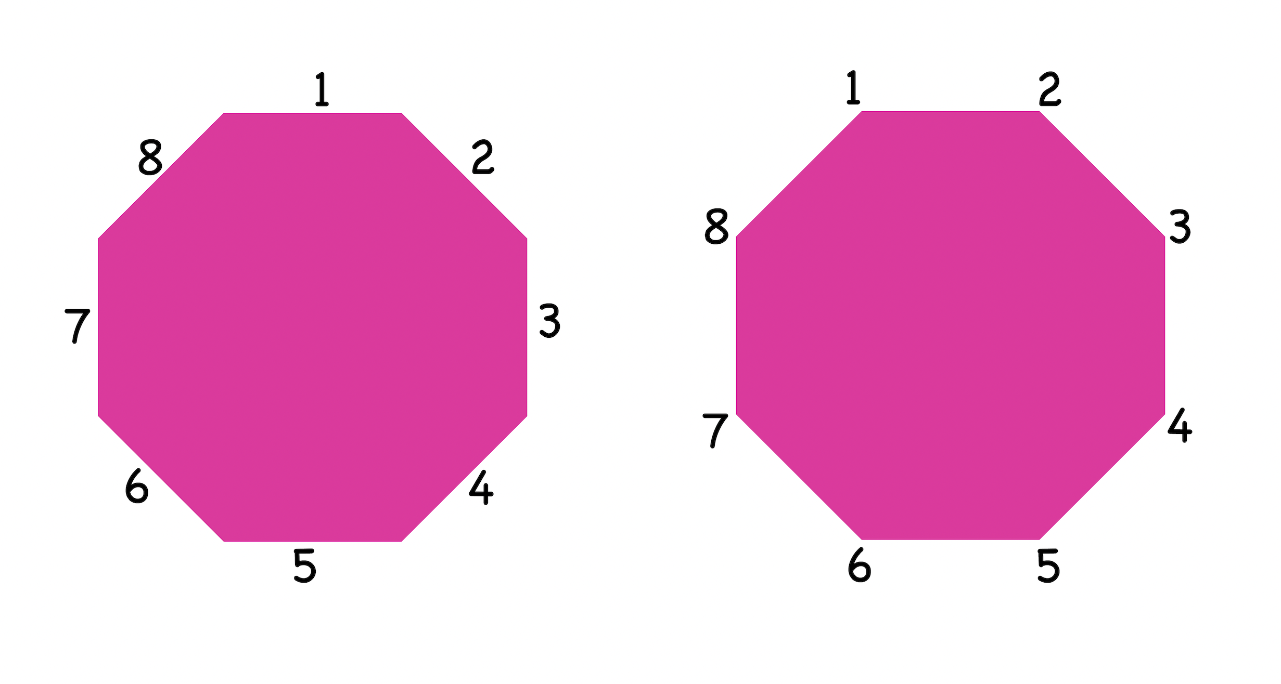
Octagon

